Slide 1
Model Inversion Attacks
Ref:
https://www.usenix.org/system/files/conference/usenixsecurity14/sec14-paper-fredrikson-privacy.pdf
https://franziska-boenisch.de/posts/2020/12/model-inversion/

Slide 2
Attack Against Neural Network

Slide 3
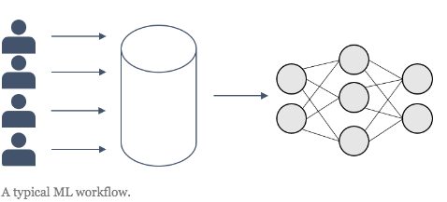
Imagine, you would like to train a classifier.
Usually, you start with some (potentially sensible) training data, i.e. some data features X and corresponding class labels y.
pick an algorithm, e.g. a neural network (NN), and then you use your training data to make the model learn to map from X to y
This mapping should generalize well, such that your model is also able to predict the correct labels for, so far, unseen data X.
′
.

Slide 4
Model inversion (MI) attacks are aimed at reconstructing training data from model parameters

Slide 5
Model Inversion Attacks
proposed by Fredrikson et al. in 2015. [https://www.cs.cmu.edu/~mfredrik/papers/fjr2015ccs.pdf][3]
face classifier trained on black and white images of 40 different individuals’ faces.
The data features X : individual image pixels that can take continuous values in the range of [0,1]
With this large number of different pixel values combinations over an image, it is inefficient to brute-force a reconstruction over all possible images in order to identify the most likely one(s).

Slide 6
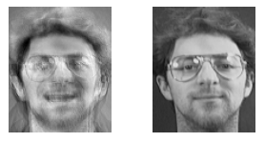
From [3]

Slide 7
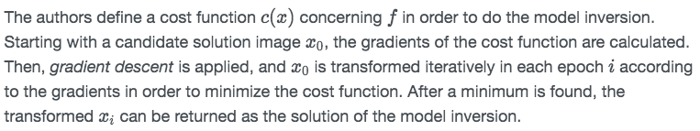
Ye slide normal hi hai

Slide 8
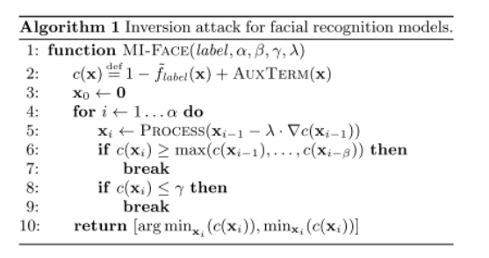
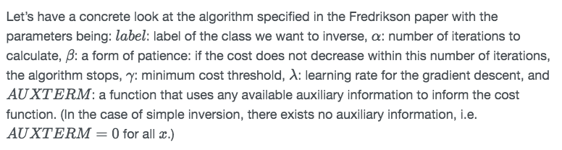
Do read

Slide 9
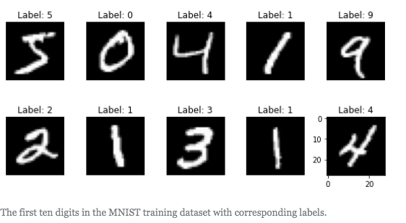
Example Code
https://github.com/Trusted-AI/adversarial-robustness-toolbox
Dataset:
MNIST dataset which consists of 60.000 training and 10.000 test black and white images of the digits from 0 to 9 with the corresponding labels:

Slide 10
disable the eager execution - For ART framework
Use KerasClassifier as a wrapper.
Take a model
Compile it with your chosen parameters
Start the Attack

Slide 11
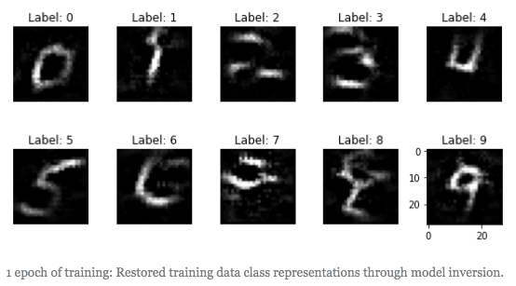
IBM-ART specifies array (x and y).
X: contains the initial input to the classifier under attack for each class label.
[not specified set as 0]

Slide 12
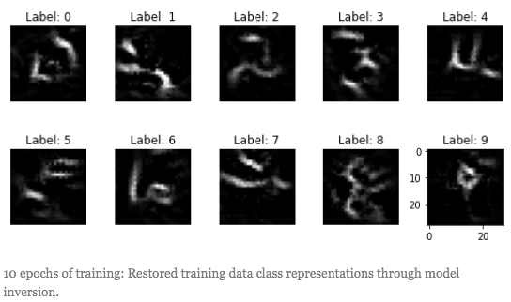
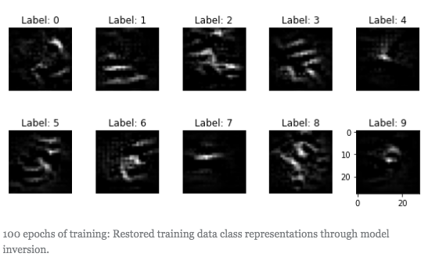

Slide 13
Attack against linear regression model f

Slide 14
Predict:
a real-valued suggested initial dose of the drug Warfarin using a feature vector consisting of patient demographic information, medical history, and genetic markers.
The sensitive attribute was considered to be the genetic marker (first feature x1.)

Slide 16
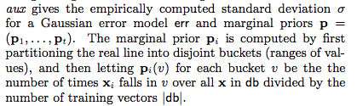
Auxiliary Information

Slide 17
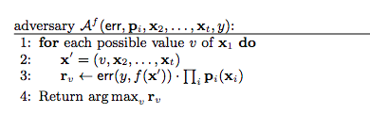
Gaussian error model will penalize x1 that force the prediction to be far from the given label y.
Least biased maximum a posteriori (MAP) estimate for x1 given the available information.
Thus, it minimizes the adversary’s misprediction rate.

Slide 18
Limitation
Not suitable when feature space is huge

Slide 19
Inversion attacks on decision trees

Slide 20
Why Decision Tree
model is used on a wide range of data
often favored because tree-structured rules are easy for users to understand.
[There are two types of decision trees common in the literature: classification (where the class variable is discrete), and regression (where the class variable is continuous).]
We focus on classification trees

Slide 21
Region
A decision tree model recursively partitions the feature space into disjoint regions R1, . . . , Rm. Predictions are made for an instance (x, y) by finding the region containing x, and returning the most likely value for y observed in the training data within that region.

Slide 22
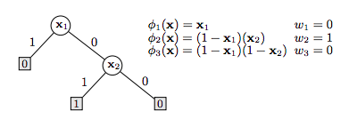


Slide 23


Classification:
Confidences :

Slide 24
Decision tree APIs
Few allows users to publish trees in either black-box or white-box mode
[Eg: BigML ]
In black-box mode, other users are only allowed to query the decision tree for predictions using a API.

Slide 25
In both settings:
the adversary has access to marginal priors for each feature of the training set ,
Access to a confusion matrix C for which Ci,j gives the number of training instances with y = i for which the model predicted label j.
White-box mode(additionally):
users are allowed to see the internal structure of the tree, as well as download.
In the white-box setting, the attacker also has access to a count ni of the number of training set instances that match path φi in the tree.

Slide 26
Objective of Attack
The adversary should output a value that maximizes for x1 [unknown sensitive feature]]

Slide 27
Black-box MI: Revisit the same algorithm
decision tree models we consider produce discrete outputs
the error model information: confusion matrix as opposed to the standard deviation of a Gaussian.

Slide 28

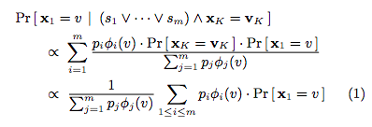
White-box MI
The adversary then outputs a value for v that maximizes (1) as a guess for x1.

Slide 29

White-box MI
Line 1: pi denote ni/N.

Slide 30
White-box MI

Slide 31
White-box MI
The adversary then outputs a value for v that maximizes (1) as a guess for x1.

Slide 32
Membership Inference Attacks

Slide 33
Ref
https://arxiv.org/pdf/1610.05820.pdf

Slide 34
given a data record and black-box access to a model, determine if the record was in the model’s training dataset.

Slide 35
To answer the membership inference question
turn machine learning against itself
train an attack model whose purpose is to distinguish the target model’s behavior on the training inputs from its behavior on the inputs that it did not encounter during training.
aIn other words, we turn the membership inference problem into a classification problem.

Slide 36
Shadow training
First, create multiple “shadow models” that imitate the behavior of the target model, but for which the training datasets are known
Thus the ground truth about membership in these dataset are known.
then train the attack model on the labeled inputs and outputs of the shadow models.

Slide 37
Generate training data for the shadow models.
Method 1
The first method uses black-box access to the target model to synthesize this data.
Method 2
The second method uses statistics about the population from which the target’s training dataset was drawn.
Method 3
The third method assumes that the adversary has access to a potentially noisy version of the target’s training dataset.
[The first method does not assume any prior knowledge about the distribution of the target model’s training data, while the second and third methods allow the attacker to query the target model only once before inferring whether a given record was in its training dataset.]

Slide 38
Inference techniques are generic:
-not based on any particular dataset or model type
[Effective for Amazon ML and Google Prediction API.
without knowing the learning algorithms used, nor the architecture of the resulting models, since Amazon and Google don’t reveal this information to the customers. ]

Slide 39
Confidence values
For any input data record, the model outputs the prediction vector of probabilities, one per class, that the record belongs to a certain class.
These probabilities are confidence values.

Slide 40
Attack Steps
Consider a set of labeled data records sampled from some population and partitioned into classes. W
assume that a machine learning algorithm is used to train a classification model that captures the relationship between the content of the data records and their labels.
assume that the attacker has query access to the model and can obtain the model’s prediction vector on any data record

Slide 41
Attacker’s Knowledge
attacker knows the format of the inputs and outputs of the model, including their number and the range of values they can take.
the attacker either
(1) knows the type and architecture of the machine learning model, as well as the training algorithm,
or (2) has black-box access to a machine learning oracle (e.g., a “machine learning as a service” platform) that was used to train the model. In the latter case, the attacker does not know a priori the model’s structure or meta-parameters

Slide 42
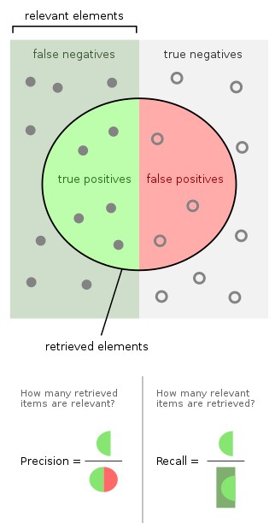
Attack Metric
Precision (what fraction of records inferred as members are indeed members of the training dataset) and
Recall (what fraction of the training dataset’s members are correctly inferred as members by the attacker).

Slide 43
Overview of the attack
Observation:
membership inference attack exploits the observation that machine learning models often behave differently on the data that they were trained on versus the data that they “see” for the first time.
Overfitting is a common reason but not the only one

Slide 44
Objective of the attacker :
construct an attack model that can recognize such differences in the target model’s behavior and use them to distinguish members from non-members of the target model’s training dataset based solely on the target model’s output.

Slide 45
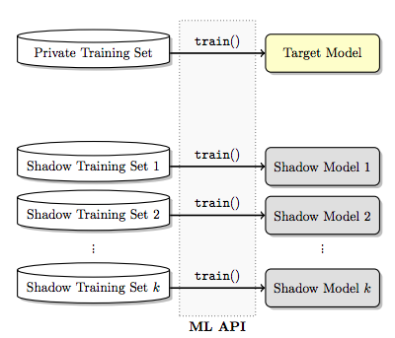
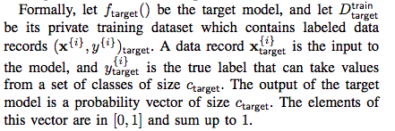
Target Model

Slide 46
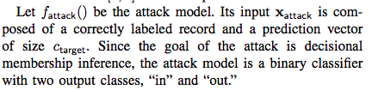
Attack Model

Slide 47
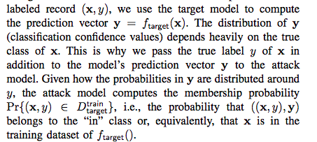

Slide 48
Shadow Models
The more shadow models, the more accurate the attack model will be.
the attack model is trained to recognize differences in shadow models’ behavior when these models operate on inputs from their own training datasets versus inputs they did not encounter during training.
Therefore, more shadow models provide more training fodder for the attack model.

Slide 49
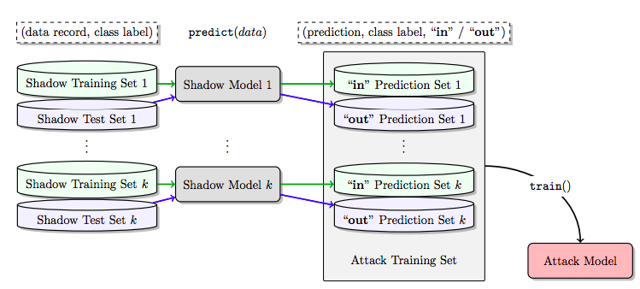

Slide 50
